Slide 1
Elementary School Closure GAme
Steps to creating a successful closure game/activity:

Slide 2
Step 1
Objective – What will the children obtain/learn from your project.
Example 1
The student will be able to identify nouns, verbs and adjectives in sentences provided.
The student will be able to create new sentences using the nouns, verbs and adjectives.
Example 2
The student will be able to recite all fifty states.
The student will be able to identify all fifty states on a map.
The student will be able to name the state bird for each of the fifty states.

Slide 3
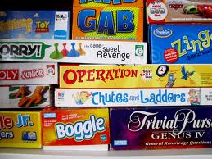
Step 2
Brainstorm
Create a list of games you liked when you were a child.
Chose a format for your game- Board Game, Race Game, Card Game or Floormat Game

Slide 4
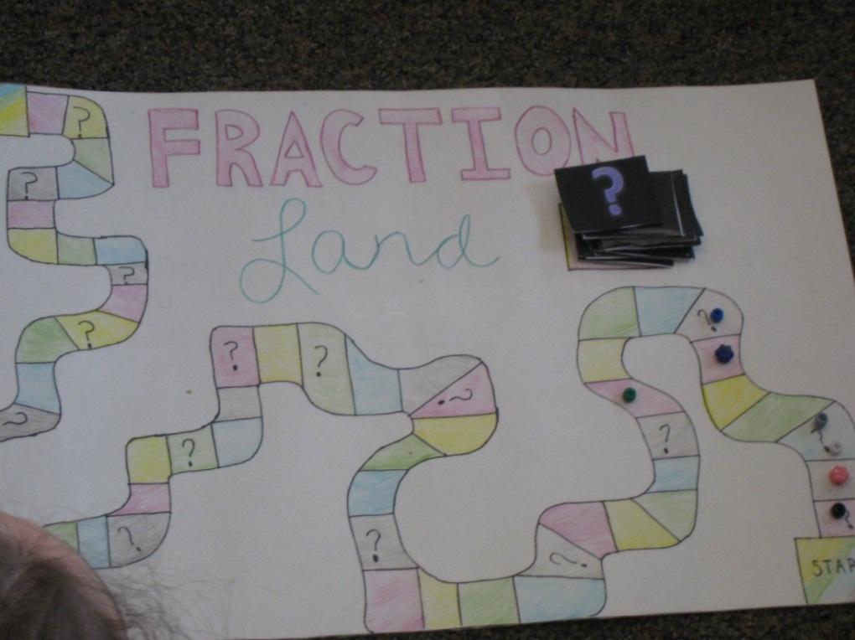
Step 3
Think about how you could adapt a game you liked as a child into a new game to teach/review information for your elementary classroom.

Slide 5
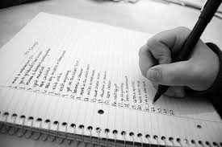
Step 4
Make a list of materials you will need for your game.

Slide 6
Step 5
Make sure your game is:
Reusable
Age appropriate
Neat and colorful
Computer generated
Laminated

Slide 7
Step 6
Be sure to include:
List of all game pieces
Step by step directions
Everything should be neatly stored in a bag, folder or box to be given to elementary teacher

Slide 8
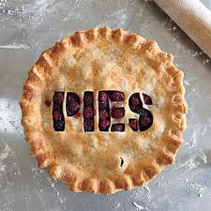
Step 7
PIES-use notes and text book
Refresh your memory about what kids at the level you will be working with are capable of doing.

Slide 9
Example

Slide 10
Example

Slide 11
Example

Slide 12
Examples

Slide 13
Example

Slide 14
Example

Slide 15
Example

Slide 16
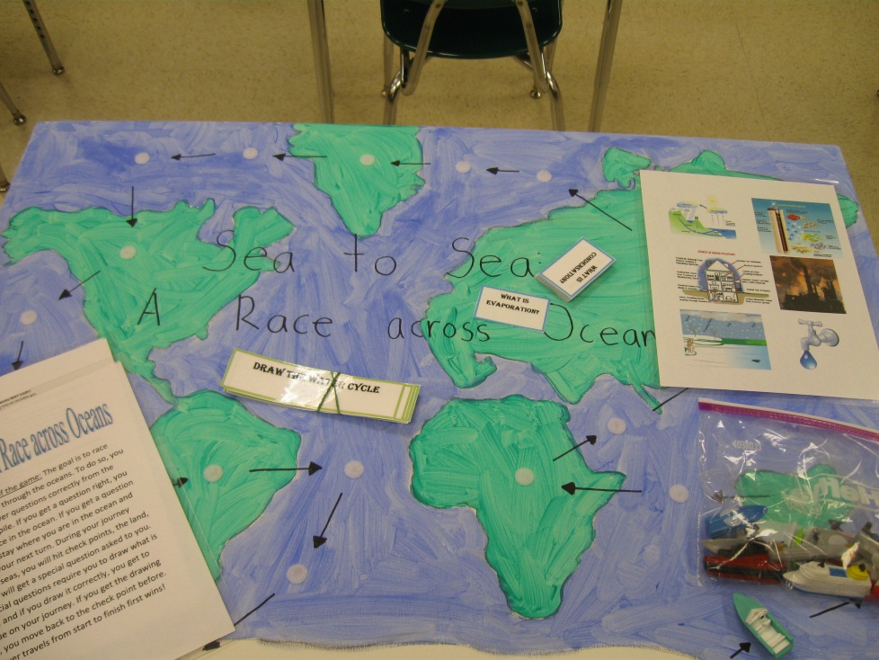
Example

Slide 17
Example

Slide 18
Example

Slide 19
Example

Slide 20
Example

Slide 21
Example

Slide 22
Example

Slide 23
Example

Slide 24
Example

Slide 25
Example

Slide 26
Example

Slide 27
Example

Slide 28
Example

Slide 29
Example

Slide 30
Example

Slide 31
Example

Slide 32
Example

Slide 33
Example

Slide 34
Example

Slide 35
Example

